Slide 1

RUNGTA COLLEGE OF DENTAL SCIENCES & RESEARCH DEPARTMENT OF ANATOMY TOPIC : INTRODUCTION TO NEUROANATOMY

Slide 2
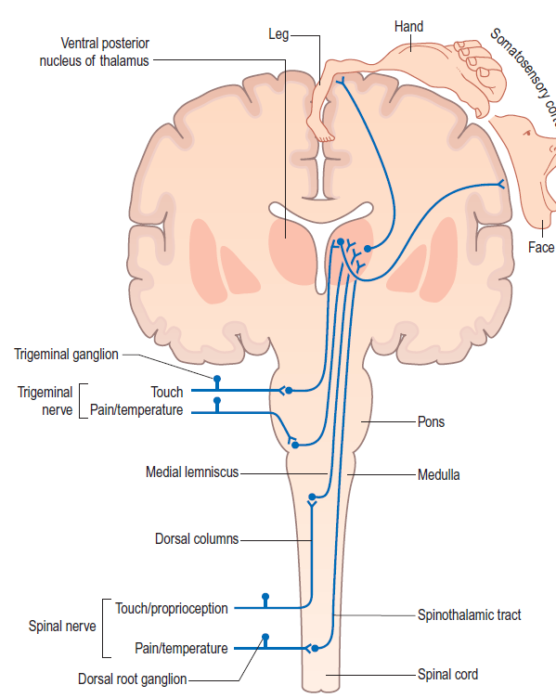
INTRODUCTION OF NEUROANATOMY

Slide 3
Study of is neuroanatomy
Monitorig , coordinating & controlling system of body with endocrine system.
Human CNS having been evolved over the last 600 million years, is the most complex living organ in the known universe.
The comprehension of neuroanatomy is crucial in any neurosurgical, neuroradiological, neuro-oncological, psychological or neurological procedure.
Functions-
Reception of sensory stimuli and to transmit them to effector organs, as muscular or glandular
Integration
Coordination & control
Storage of experiences, memory.

Slide 4
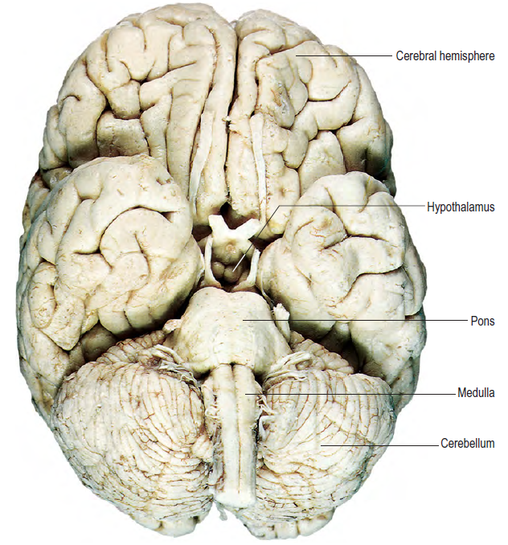

Slide 5
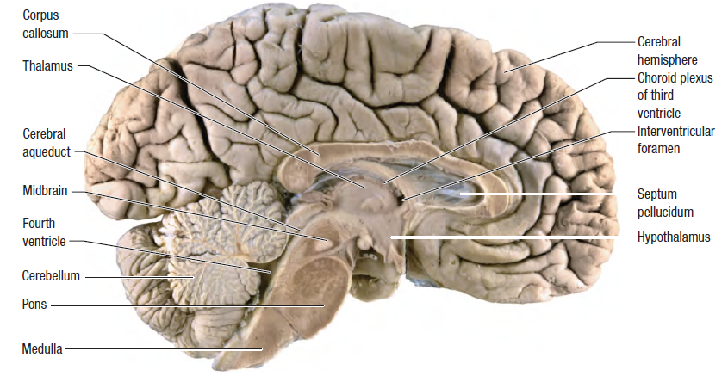

Slide 6
DIVISION-
Developmental-
Forebrain(prosencephalon)-Telencephalon (cerebrum)-lateral ventrical -Diencephalon (thalami)-3rd ventrical
Midbrain (mesncephalon)- - - - - - - - - -cerebral aqueduct
Hindbrain(rhombencephalon)-metencephalon-pons
- 4th ventricle -Myelencephalon- M O
Anatomical- CNS- brain and spinal cord & PNS- cranial and spinal
Nerves and their associated ganglia, innervates directly or through plexuses
Functional- afferents& efferents
Efferents- has somatic & visceral components constitute somatic & autonomic
somatic-voluntary for skeletal
autonomic- involuntary for hrt, smooth mscl, glands, spinal cord

Slide 7
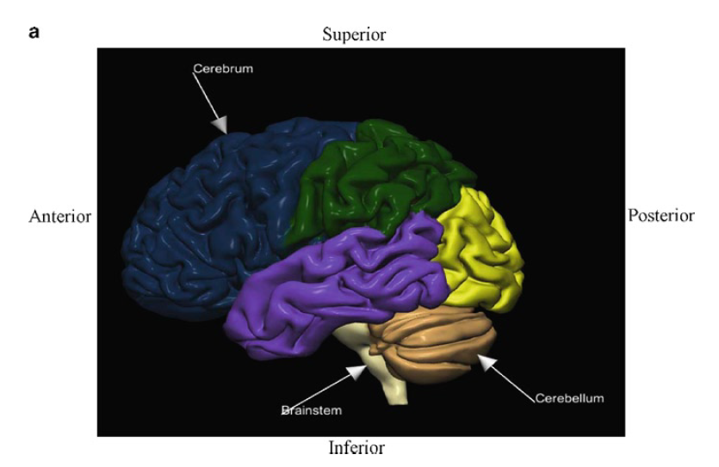

Slide 8
Cellular organisation- Nervous system is composed basically of specialized excitable nerve cells and their processes , primary- neuron Secondry- glial cells.
Neurons- motor –upper& lower, sensory, polar, golgi type
CNS consists of the brain and the spinal cord.
Brain encases the fluid-filled ventricular system -Contains four interconnected cerebral ventricles (cavities) filled with cerebrospinal fluid (CSF)
• Left and right lateral ventricles
• Third ventricle
• Fourth ventricle
CSF is secreted mainly in the choroid plexus (a network of vessels) and circulates from the lateral ventricles through the paired interventricular foramina (of Monro) to the third ventricle, and then via the aqueduct to the fourth ventricle. The lateral ventricles are the largest and each contains Body (or central portion), Atrium (or trigon), Horns
–– Frontal (anterior)
–– Occipital (posterior)
–– Temporal (inferior

Slide 9
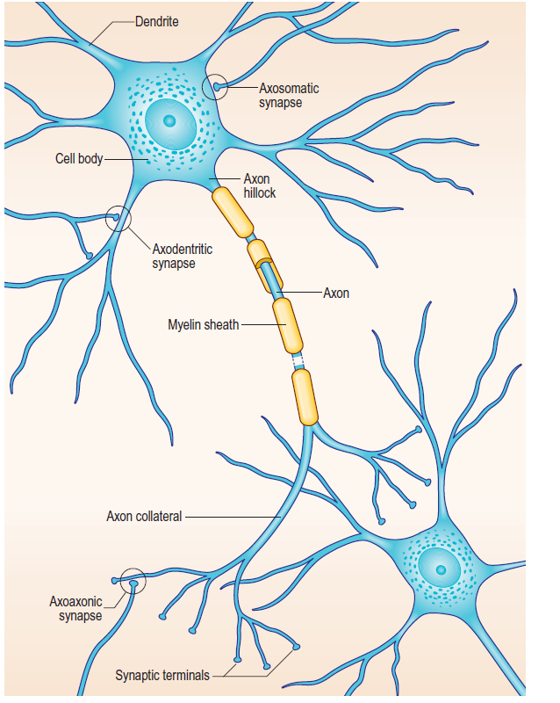

Slide 10
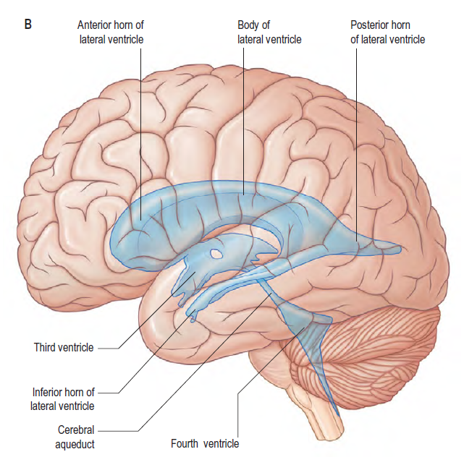

Slide 11
3 main components
I. Cerebrum
Cerebrum comprises:
• Left and right cerebral hemispheres, largest compartment of the brain and are interconnected by white matter fibers
Hemispheres are composed of:
Outer gray matter termed the cerebral cortex
Cortex has three surfaces: lateral, medial, and inferior (also called basal or ventral). Functional Areas
Several divisions are introduced to subdivide the cortical regions into functional areas. Brodmann’s areas based on histology is the most widely used and it is illustrated in axial orientation.
Brodmann’s areas are useful in neuroscience and functional studies.
Inner white matter encompassing the deep gray nuclei
• Interbrain between the cerebrum and the brainstem termed the diencephalon
• Deep gray nuclei- Subcortical masses of grey matter

Slide 12
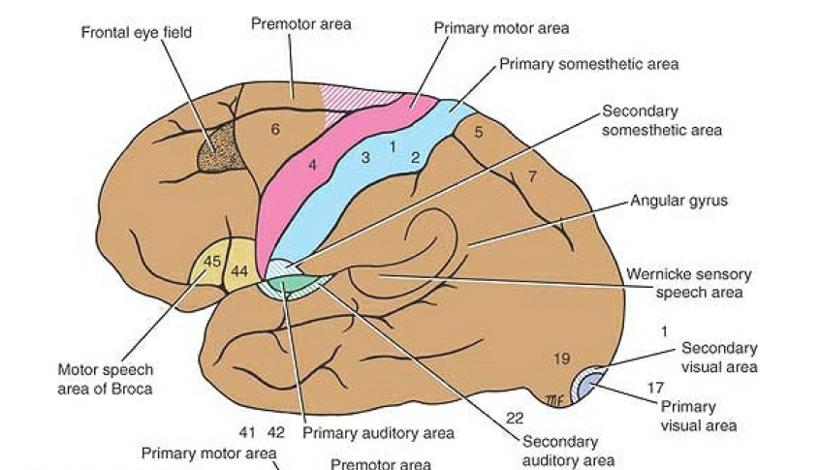

Slide 13
Deep Gray Nuclei
The deep gray nuclei are paired gray matter structures. Main deep gray nuclei are
• Basal ganglia (nuclei)
–– Caudate nucleus
–– Lentiform nuclei
–– Putamen
–– Globus pallidus
–– Lateral (or outer) segment
–– Medial (or inner) segment
• Thalamus
• Hippocampus
• Amygdala (amygdaloid body)
The lentiform nuclei and the caudate nucleus form the striatum
II.Cerebellum (the little brain) composed of Left and right cerebellar hemispheres& Midline vermis which unites them
III. Brainstem -subdivided into
Midbrain,Pons,Medulla

Slide 14
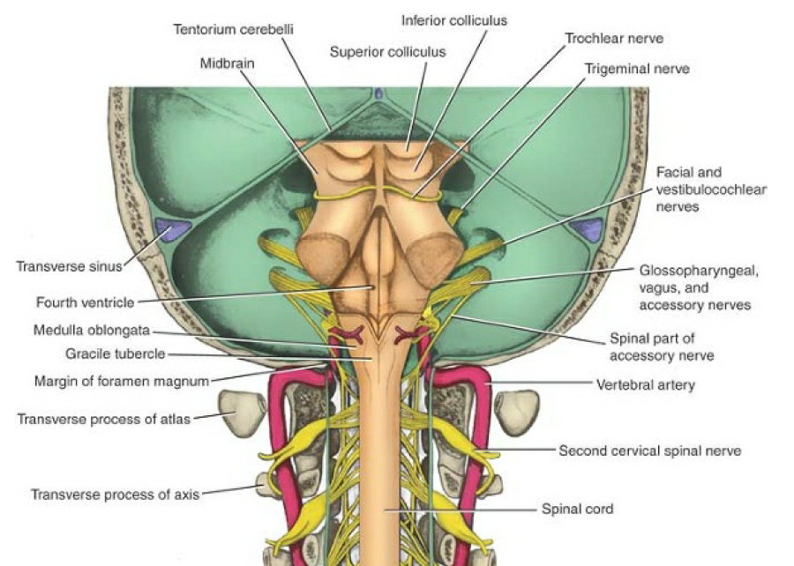

Slide 15
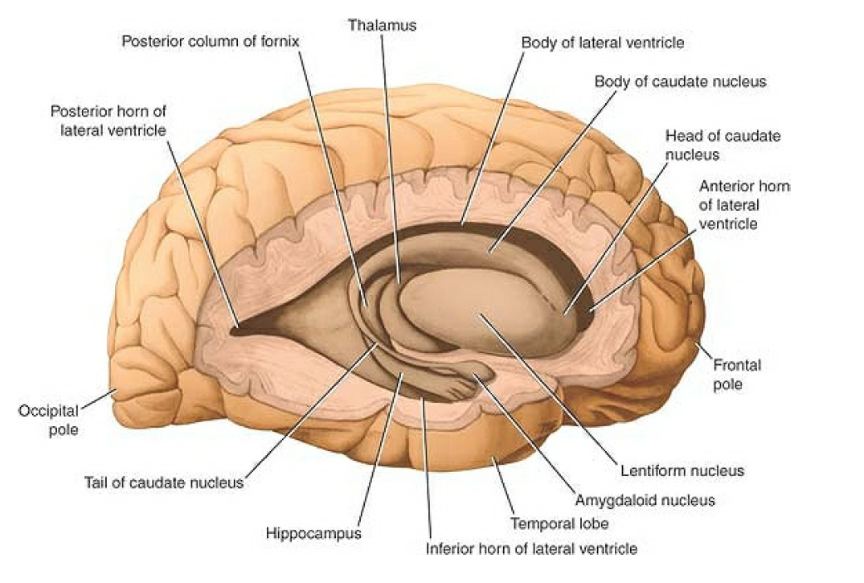

Slide 16
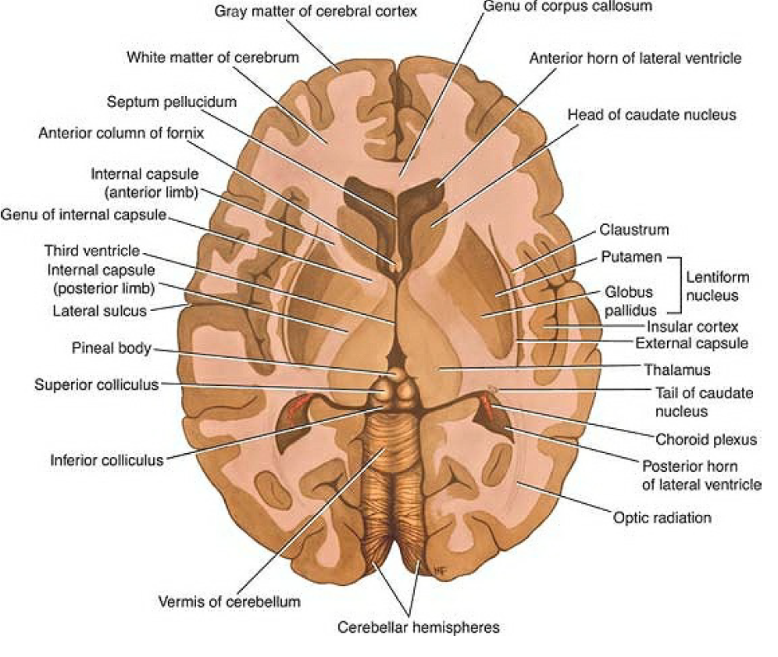

Slide 17
Interior of CNS is organized into gray and white matter.
Gray matter consists of nerve cells embedded in neuroglia; it has a gray color.
White matter consists of nerve fibers embedded in neuroglia; it has a white color due to the presence of lipid material in the myelin sheaths of many of the nerve fibers.
The gray matter contains mainly nerve cell bodies, while white matter is made up predominantly of nerve fibers (axons).
The cerebral cortex is highly convoluted.
The folds form gyri that are separated by grooves called sulci or fissures (deep sulci).
Cerebral hemispheres contain five lobes
• Frontal lobe
• Temporal lobe
• Parietal lobe
• Occipital lobe

Slide 18
Transitional areas form the frontal, temporal, and occipital poles
SURFACES OF BRAIN
Lateral Surface
Four lobes are present on the lateral surface: frontal, temporal, parietal, and occipital,
The lateral surface of the frontal lobe is subdivided by 3 sulci (superiorfrontal sulcus, inferior frontal sulcus, and precentral sulcus) into 4 gyri
• Superior frontal gyrus
• Middle frontal gyrus
• Inferior frontal gyrus
• Precentral gyrus
The lateral surface of the temporal lobe is subdivided by 2 sulci (superior temporalsulcus and inferior temporal sulcus) into 3 gyri .
• Superior temporal gyrus
• Middle temporal gyrus
• Inferior temporal gyrus

Slide 19
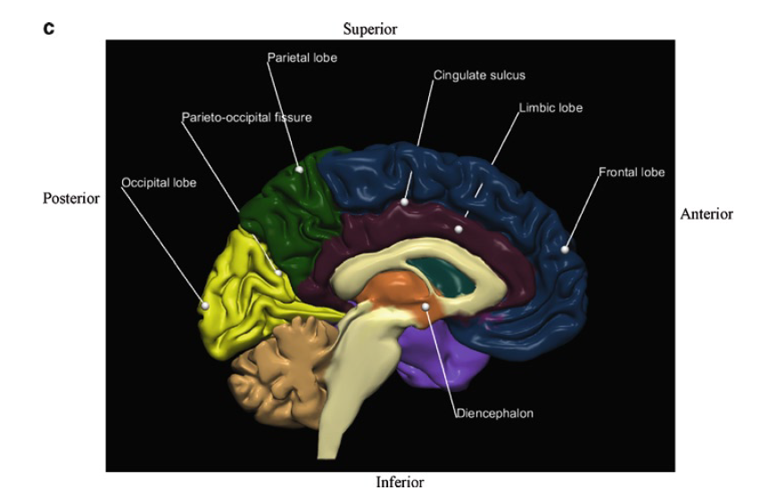

Slide 20
The lateral surface of the parietal lobe is subdivided by the intraparietal sulcus
into three gyri.
• Postcentral gyrus
• Superior parietal gyrus (lobule)
• Inferior parietal gyrus (lobule)
–– Supramarginal gyrus
–– Angular gyrus
The lateral surface of the occipital lobe is subdivided by 2 sulci (superior occipitalsulcus and inferior occipital sulcus) into 3 gyri.
Superior occipital, Middle occipital, Inferior occipital,
Medial Surface
The frontal, parietal, occipital, and limbic lobes are present on the medial surface.
The limbic lobe contains the gyri located at the inner edge (or limbus) of the hemisphere including -Subcallosal gyrus (areas), Cingulate gyrus, Isthmus (of cingulate gyrus), Parahippocampal gyrus

Slide 21
The superior frontal gyrus (separated from the limbic lobe by the cingulate sulcus occupies most of the medial surface of the frontal lobe.
Parietal lobe includes the precuneus, (separated from occipital lobe by parieto-occipital fissure. Occipital lobe comprises the cuneus and lingual gyrus.
Inferior Surface includes the frontal, temporal, and occipital lobes. The frontal lobe comprises.
• Orbital gyri divided by the H-shape sulcus into the anterior, medial, lateral, and posterior orbital gyri.
The temporal and occipital lobes of inferior are subdivided by two sulci (lateral occipitotemporal and medial occipitotemporal (collateral) sulcI into three gyri.
• Medial occipitotemporal gyrus whose temporal part constitutes the parahippocampal gyrus and the occipital part the lingual gyrus
• Lateral occipitotemporal gyrus (called also the fusiform gyrus)
• Inferior temporal gyrus
The lingual gyrus is separated from the cuneus by the calcarine sulcus (fissure).

Slide 22
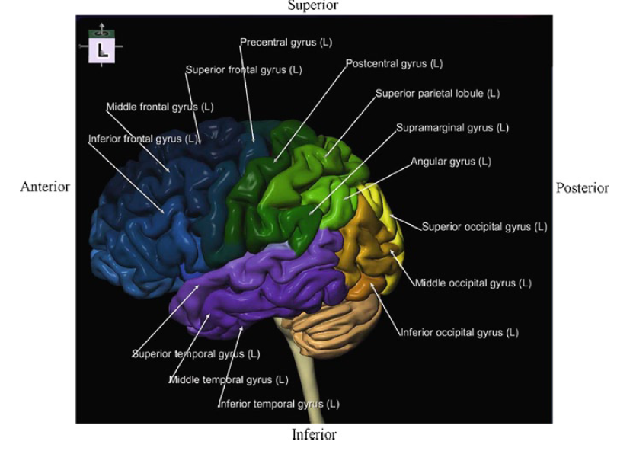

Slide 23
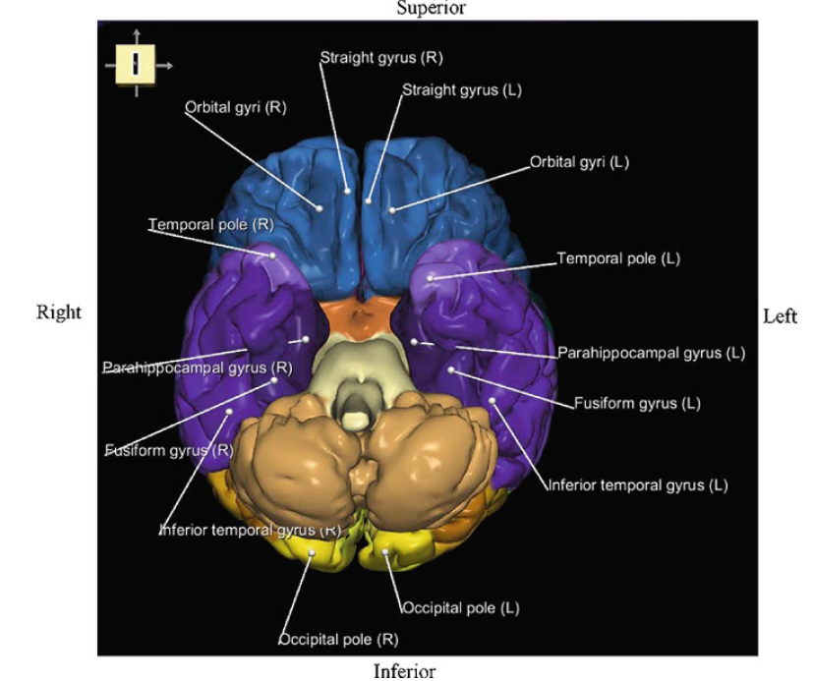

Slide 24
Central sulcus separates the frontal lobe anterior from the parietal lobe posterior.
The Sylvian (lateral) fissure demarcates the temporal lobe below from the frontal and parietal lobes above.
The parieto-occipital fissure separates the parietal lobe anterior from the occipital lobe posterior.
The cingulate sulcus separates the frontal lobe above from the limbic lobe below.
COVERINGS or MENINGES
CRANIAL & SPINAL Meninges
Both the brain and spinal cord are covered with a system of membranes, called meninges, and are suspended in the cerebrospinal fluid.
They are further protected by the bones of the skull and the vertebral column

Slide 25
Autonomic Nervous System
Part of nervous system concerned with innervation of involuntary structures, as heart, smooth muscle, and glands within the body.
It is distributed throughout the central and peripheral nervous systems.
ANS divided into two parts, the sympathetic and the parasympathetic, and in both parts, there are afferent and efferent nerve fibers.
The activities of the sympathetic part prepare the body for an emergency& parasympathetic part aimed at conserving and restoring energy
Spinal Cord
It is Situated within the vertebral canal and is surrounded by three meninges-Dura mater, Arachnoid mater, Pia mater. Also protected by CSF, which surrounds spinal cord in the subarachnoid space.
Roughly cylindrical and begins superiorly at the foramen magnum in the skull, where it is continuous with medulla oblongata of the brain.
Terminates inferiorly in the lumbar region. Below, the spinal cord tapers off into conus medullaris, from the apex a prolongation of the pia mater, the filum terminale, descends to attach to the back of the
coccyx

Slide 26
Along the entire length of the spinal cord are attached 31 pairs of spinal nerves by the anterior or motor roots and the posterior or sensory roots .
Each root is attached to the cord by a series of rootlets, which extend the whole length of the corresponding segment of the cord.
Each posterior nerve root possesses a posterior root ganglion, the cells of which give rise to peripheral and central nerve fibers.
Spinal cord segments-
Vascular Neuroanatomy
Left and right internal carotid arteries anteriorly
• Left and right vertebral arteries posteriorly forming the basilar artery
interconnected by the circle of Willis.
ICA branches into the anterior cerebral artery and the middle cerebral artery .
The left and right posterior cerebral arteries originate from the basilar artery.
Through different segmental branches various parts of CNS are supplied.

Slide 27
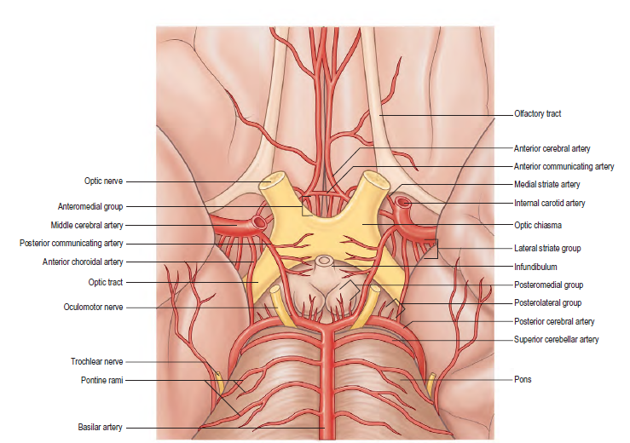

Slide 28


